Slide 1

Ajua: On-Chain African Strategy Revival

Slide 2
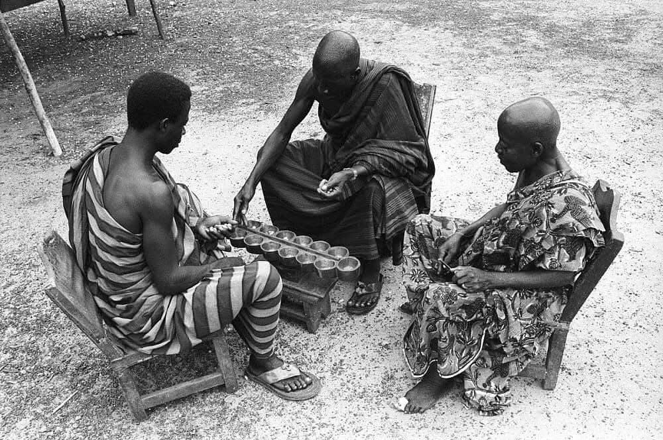
Playing The Ajua Game ->

Slide 3








Crisis & Vision
Tech & Edge
Impact & Call
Product & Market
Traction & Roadmap

Slide 4



01
Crisis & Vision

Slide 5
African Strategy Games Face Digital Oblivion
0%
African Game Representation
100+
Traditional African strategy games are vanishing from digital platforms, creating a $200B gaming blind spot. Generational knowledge transfer is collapsing as youth embrace global entertainment, pushing African strategic heritage toward extinction.
Digital Chess Versions

Slide 6
Ajua Reclaims Culture via Blockchain AI
Cultural Fidelity Engine
AI Cultural Transmission
Elder-verified authentic rule preservation.
Intelligent coaching with cultural context.
Blockchain Memory Bank
Inclusive Economic Infrastructure
Immortal game records on Hedera.
HBAR rewards for cultural mastery.

Slide 7
02
Product & Market

Slide 8

Platform Delivers Authentic Play-to-Learn
The Ajua platform offers faithful digital gameplay and real-time AI coaching, creating an engaging play-to-learn experience.
Authentic Gameplay
Faithful digital implementation of traditional Ajua/Bao.
AI Game Coach
Real-time strategy assistance and cultural education.
HBAR Rewards
Testnet cryptocurrency for winners.

Slide 9
Serve 200M African Mobile Gamers
We target key segments riding a 20% CAGR mobile growth wave across Africa.
African Youth (15-35)
Educational Institutions
Diaspora Communities
Digital natives seeking cultural connection.
Integrating heritage into curricula.
Maintaining cultural identity abroad.

Slide 10
Unlock $500M Preservation Funding
Our addressable markets span multiple high-value sectors, positioning Ajua as the first-mover.
Cultural Preservation
Educational Gaming
Blockchain Gaming
African Mobile
$500M+
$8B
$4.6B
200M+

Slide 11
03
Tech & Edge

Slide 12

Hedera AI Stack Rewards Cultural Mastery
Our stack merges cutting-edge tech to reward players for mastering their heritage.
Hedera Integration: HBAR payouts & immutable storage.
OpenAI Coaching: Personalized, culturally-aware learning.
Cultural Rule Engine: Algorithmic preservation of verified mechanics.
Progressive Web App: From CLI to mobile evolution.

Slide 13
04
Traction & Roadmap

Slide 14
Testnet Live, $50K to Scale Mobile
Core game engine developed
Core engine functional, Hedera integrated, AI coaching prototyped. Hackathon delivered HBAR rewards & on-chain recording.
Hedera testnet integration complete
AI coaching prototype functional
Next Phase Funding Goal
$50K
Cultural rule validation system built
For mobile development and user acquisition.

Slide 15
Vision: 50 Games, 100 Schools, $1M Rewards
Within five years, Ajua will establish a sustainable model for global cultural preservation.
→
→
→
50+ Games
$1M+ Rewards
100+ Schools
AI Research Hub
Digitally Preserved
Distributed to Players
Across Africa
For African Strategy

Slide 16
05
Impact & Call

Slide 17
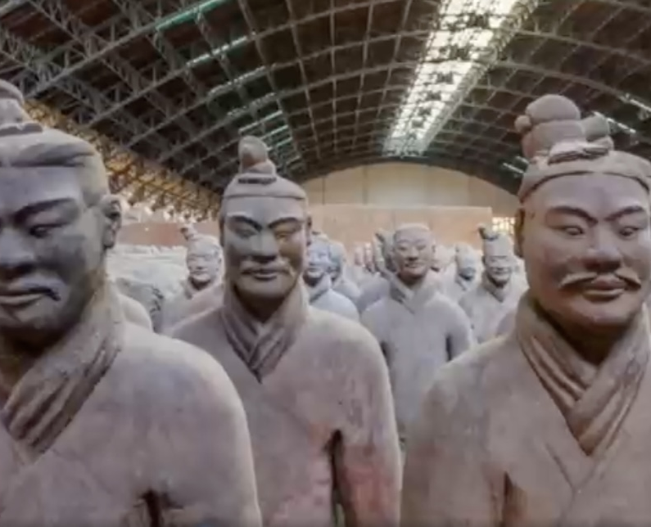
A Digital Ark for Cultural Intelligence
Ajua is more than a game; it's a digital ark safeguarding African strategic heritage and creating a replicable blueprint to rescue endangered practices worldwide.
Cultural Preservation: Proves blockchain can sustain culture beyond finance.
Global Impact: A replicable model for rescuing endangered cultural practices.
Rightful Place: Giving African traditions their place in gaming history.

Slide 18



